Slide 1
INTRODUCTION TO GITLAB

Slide 2
Gitlab
Is a web based repository manager that combines codes, review codes, into a single ui. Gitlab is a large community that has open source projects.

Slide 3
Centralized Version Control VS Distributive Version Control
Server
Lizette
Angelo
Ken
CVS is designed to work on one true source. All developers work on that source and any changes will affect that one true source

Slide 4
Centralized Version Control VS Distributive Version Control
DVCS does not rely on a central server to store all the versions of a project’s file. Every developer can get a “clone” of the repository and the full history on his own local drive. Any changes on the project files are called “commit”.
Lizette
Server
Ken
Angelo

Slide 5
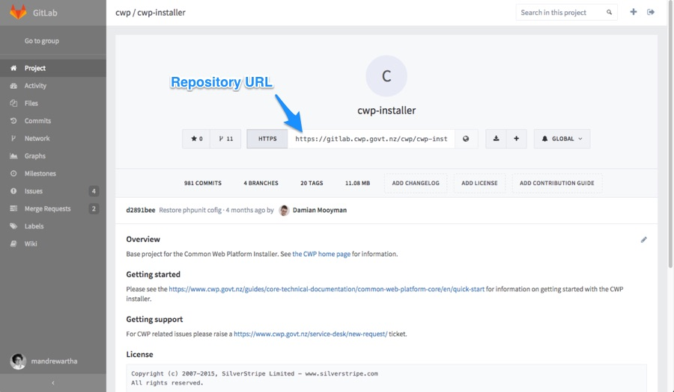
Repositories
Is what we use to store the project’s files in Gitlab and change it with version control.

Slide 6
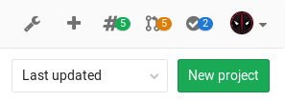
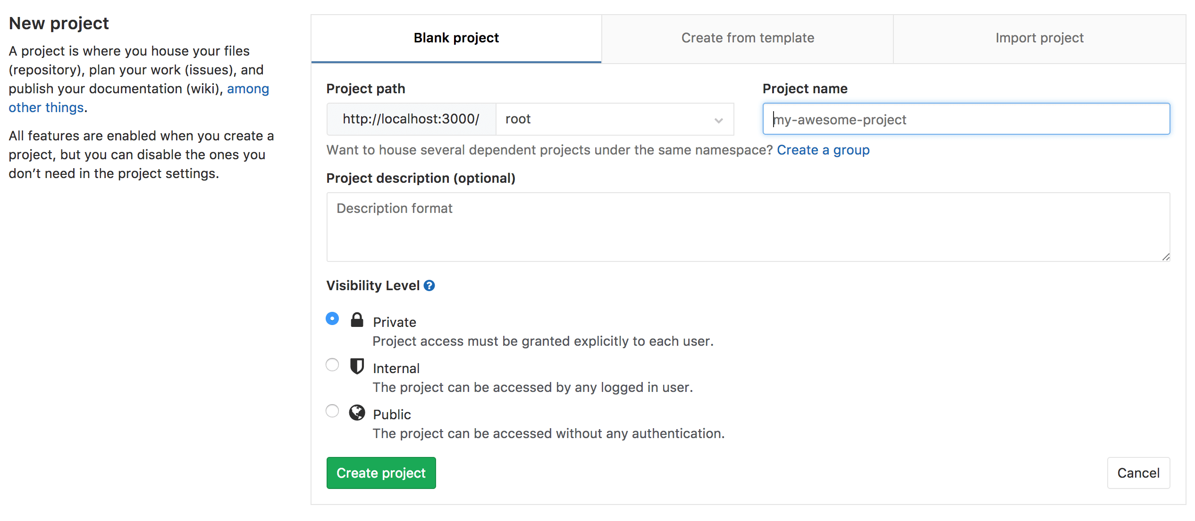
Creating a Repository
Create a repository by creating a new project
Steps on Creating a Repository
In the dashboard, click the green button “New Project”
The new project page will display

Slide 7
Creating a Repository
3. You can select blank project, or you can start with templates that are already available: this will start the repository code and CI automatically. You can also import existing project from a different repository by clicking on the Import Project tab, if given that this was enabled in the GitLab instance.
*Verify with the administrator if not
4. Enter the following information
*Enter name of your project.
*Enter Project Description (Optional)
*Visibility Level is use to modifies project’s read and access rights for users
5. Click on Create Project
External Link : https://docs.gitlab.com/ce/gitlab-basics/create-project.html

Slide 8
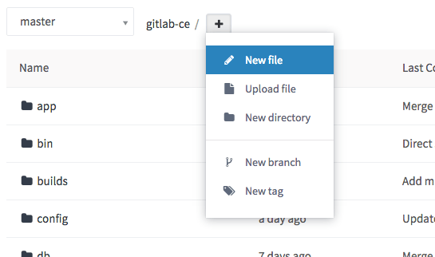
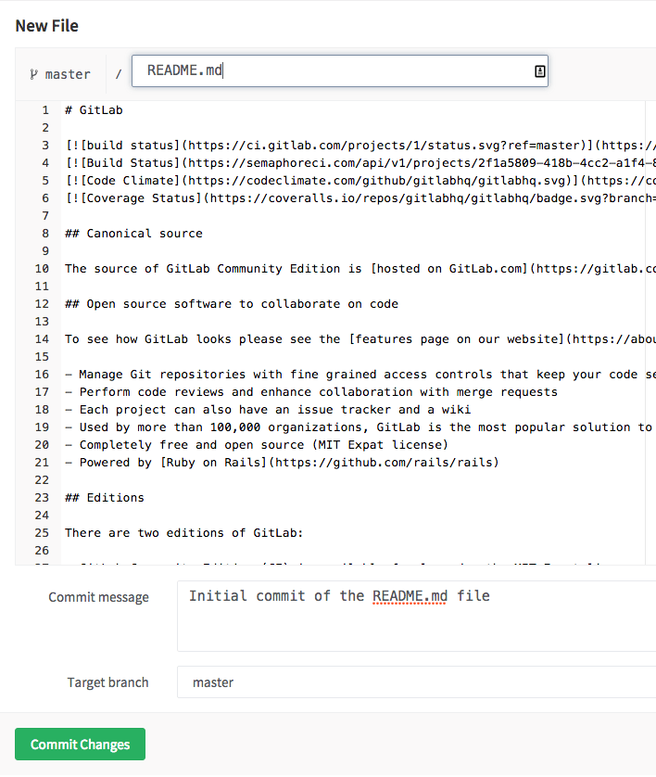
Creating a File
1. From a project's files page, click the '+' button to the right of the branch selector. Choose New file from the dropdown.
2. Enter a file name on the file name field. Then, you can add the content in the editor area. The branch field will default to the branch you were viewing in the file browser. If you enter a new branch name, a checkbox will appear allowing you to start a new merge request after you commit the changes.
Once completed, click on commit changes button at the bottom part.

Slide 9
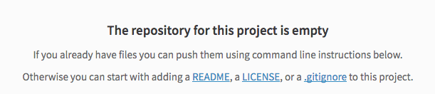
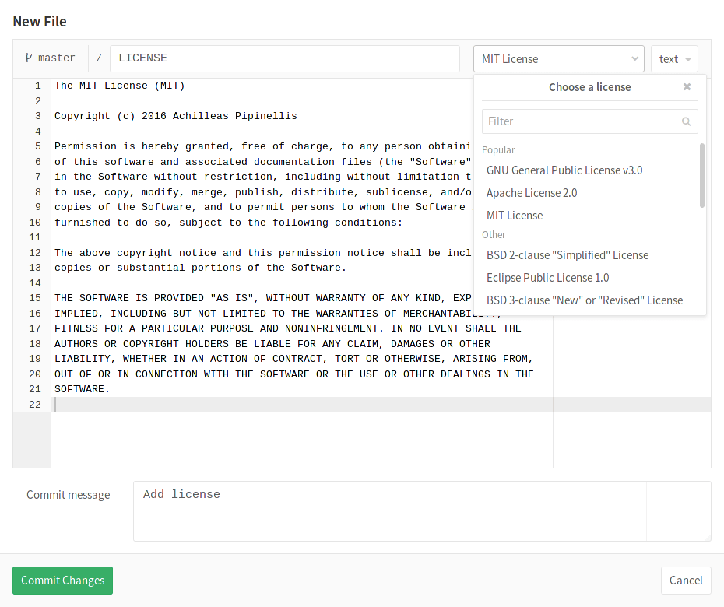
Using Template Dropdowns
When starting a new project, some files may be needed for your project. A message will be displayed to you if this happen.
When clicking on either LICENSE or gitignore, a dropdown will be displayed. It will show you available templates that is suitable to use for your project.

Slide 10
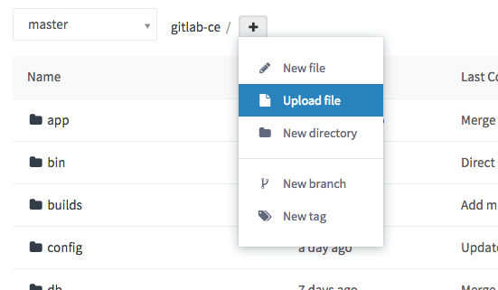
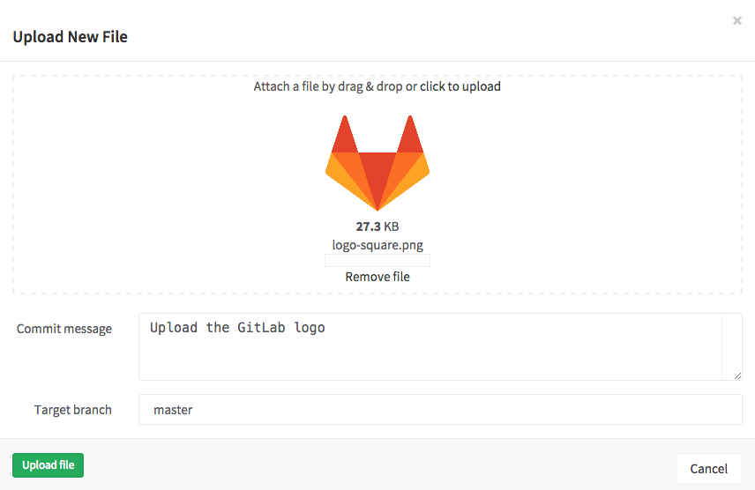
Upload a file
To upload a file, click the plus sign button (+) to the right of the branch selector of the project’s files page. A dialog box will appear. You can drag the item or click the link click to upload. After selecting the file, enter a commit message, choose a branch, and click the upload file.

Slide 11
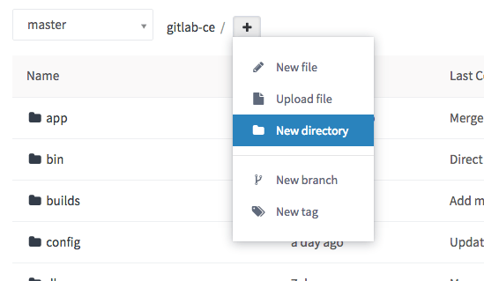
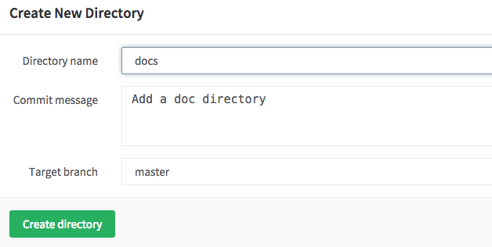
Creating directory
Having the repository organized is relevant for easy access of codes. It is often helpful create new directory.
On the project’s file page, click the plus sign (+) button to the right of the branch selector. Click the new directory from the dropdown. A new dialog window will display, enter a directory name and select the target branch, then click on create directory.

Slide 12

Creating branch
There are two ways to create a new branch,
1. This is introduced in GitLab 8.6
In case your development workflow dictates to have an issue for every merge request, you can quickly create a branch right on the issue page which will be tied with the issue itself. You can see a New branch button after the issue description, unless there is already a branch with the same name or a referenced merge request.
Once you click it, a new branch will be created that diverges from the default branch of your project, by default master. The branch name will be based on the title of the issue and as a prefix, it will have its internal ID. Thus, the example screenshot above will yield a branch named 2-et-cum-et-sed-expedita-repellat-consequatur-ut-assumenda-numquam-rerum.
Since GitLab 9.0, when you click the New branch in an empty repository project, GitLab automatically creates the master branch, commits a blank README.md file to it and creates and redirects you to a new branch based on the issue title. If your project is already configured with a deployment service (e.g. Kubernetes), GitLab takes one step further and prompts you to set up auto deploy by helping you create a .gitlab-ci.yml file.
After the branch is created, you can edit files in the repository to fix the issue. When a merge request is created based on the newly created branch, the description field will automatically display the issue closing pattern Closes #ID, where ID the ID of the issue. This will close the issue once the merge request is merged.

Slide 13
test

Slide 14
Notes
“The Visual Studio Plugin installation instructions can be found on PDN. You must install Microsoft Visual Studio 2015 first, and then the plugin installation is very similar to Studio.
https://pdn.pega.com/documents/pega-robotic-automation-studio-plug-80-installation-instructions “
https://pdn.pega.com/community/product-support/question/integrate-tfsgithubsvn-open-span
“Pega Robotics Studio does not support integrated source control. To use integrated source control you must use the Visual Studio Plugin version. You would configure TFS or any other source control provider the same as you would for any other type of project in Visual Studio.”
https://pdn.pega.com/community/product-support/question/integrate-tfsgithubsvn-open-span
“You cannot allow SVN to merge any of the Pega Robotics code. Each item must be checked out and locked by the developer working on it. When they finish, then the next developer can check out the updated copy and modify it, but changes cannot be merged using source control.
Since the developer writing the automations needs to understand how the adapter works, we typically assign one developer to each adapter. This way, they perform the interrogation as well as the automation. This is the most efficient way we have found to allocate resources.”
https://pdn.pega.com/community/product-support/question/multiple-developers-working-single-openspan-solution-through
“When saving the osproj file after editing the project properties, data is updated in up to two other files. These files are located in the Properties folder (ImportTypeMap.resx and MessageManifest.resx). You therefore should check out these files as well when editing the project properties. You will receive a warning if these files are not checked out and your changes will not save. “
https://pdn.pega.com/community/pega-product-support/question/team-foundation-server-tfs-integration-openspan-studiopega

